Slide 1
Y-Bus
Experiment_4

Slide 2
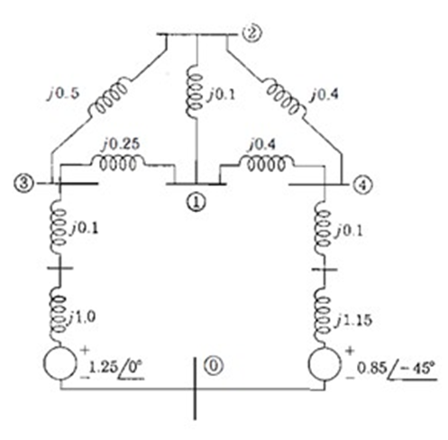

Slide 3
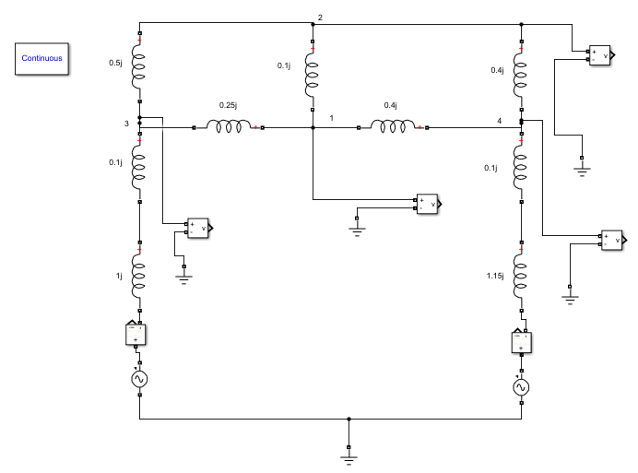

Slide 4
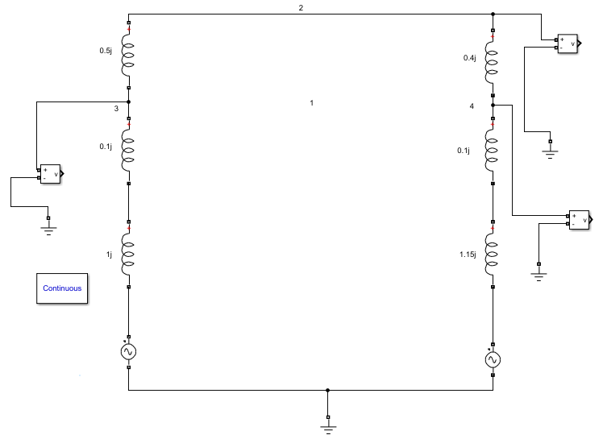

Slide 5


Slide 6


Slide 7
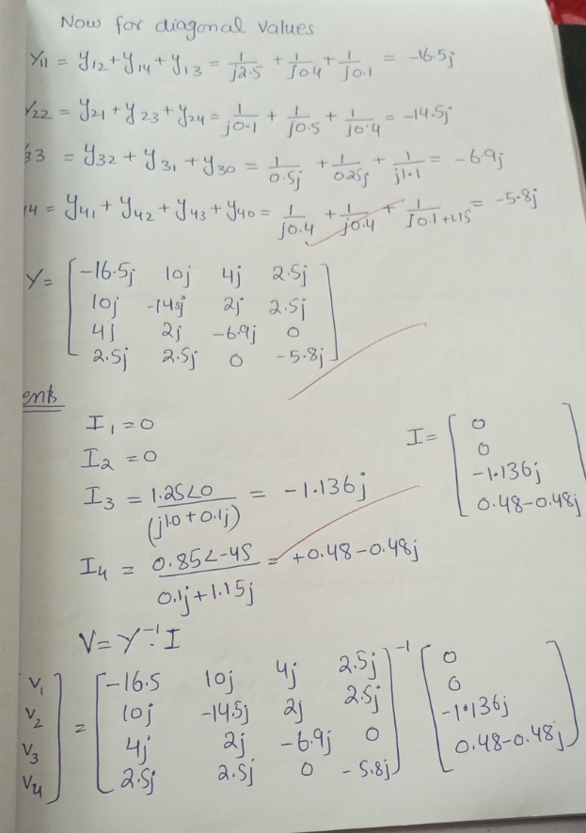

Slide 8
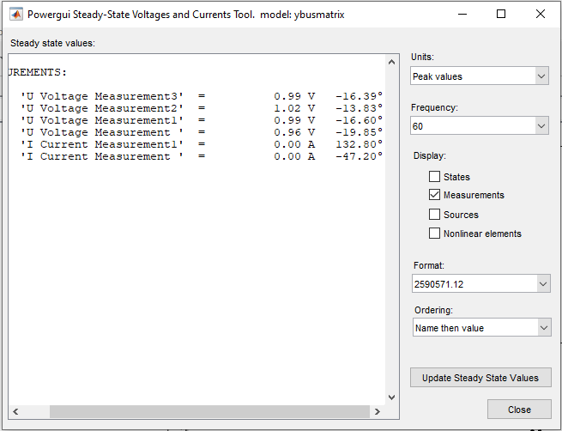

Slide 9
Task1 :
Create circuit in Simulink and find the value Voltages in steady state
Find Y bus by hand calculation and I matrix, Calculate value of V using MATLAB (Y bus inverse I).
Task 2:
Kron reduction method to eliminate Bus 1, and follow same procedure of Step 1.
At end make tables in MS Word and compare Simulink values with calculated values.

